Slide 1
Design and Analysis of Algorithms CS345
Lecture 35
Fibonacci Heap - II

Slide 2
quick revision A binomial HEAP
A collection of
Binomial trees
Heap ordered

Slide 3

Binomial Tree
$B_{k}$
Binomial tree of degree $k$

Slide 4








$B_{k}$: Binomial tree of degree $k$
No. of nodes in $B_{k}$ = ?
$N\left(k\right)= …$
$$B_{k−1}$$
$$B_{k−1}$$
$$B_{k}$$
$$2^{k}$$
$$1$$
$$4$$
$$6$$
$$4$$
$$1$$
$$2 N\left(k−1\right)$$
$$B_{4}$$

Slide 5







Binomial heap of size $n$
Least
significant
bit
Most
significant
bit
$$0$$ | $$1$$ | $$2$$ | $$3$$ | $$4$$
$$n=19$$
$$1$$ | $$1$$ | $$0$$ | $$0$$ | $$1$$
Head
$$B_{0}$$
$$B_{1}$$
$$B_{4}$$

Slide 6
Binomial heap of size $n$
$$0$$ | $$1$$ | $$2$$ | $$3$$ | $$4$$
$$n=19$$
$$1$$ | $$1$$ | $$0$$ | $$0$$ | $$1$$
How to implement this structure ?
Head
3
5
1
9
2
7
4
9
8
7
6
19
23
67
$$B_{0}$$
$$B_{1}$$
$$B_{4}$$
26
91
12
63
34

Slide 7
Binomial heap of size $n$
$$0$$ | $$1$$ | $$2$$ | $$3$$ | $$4$$
$$n=19$$
$$1$$ | $$1$$ | $$0$$ | $$0$$ | $$1$$
Head
3
5
1
9
2
7
4
9
8
7
6
19
23
67
$$B_{0}$$
$$B_{1}$$
$$B_{4}$$
26
91
12
63
34

Slide 8
Binomial heap of size $n$
$$0$$ | $$1$$ | $$2$$ | $$3$$ | $$4$$
$$n=19$$
$$1$$ | $$1$$ | $$0$$ | $$0$$ | $$1$$
Head
3
5
1
9
2
7
4
9
8
7
6
19
23
67
$$B_{0}$$
$$B_{1}$$
$$B_{4}$$
26
91
12
63
Degree
Key
34
Parent
Left
Right
Structure of a node

Slide 9


















Operations on a Heap
 | Binary heap
Binomial heap
Binomial heap
Maintain
it explicitly
Find-min($H$)
O($1$)
O($\log{n}$)
O($1$)
Insert($H$, $x$)
O($\log{n}$)
O($\log{n}$)
O($1$)
Extract-min($H$)
O($\log{n}$)
O($\log{n}$)
O($\log{n}$)
amortized
Decrease-key($H$,$x$,$y$)
O($\log{n}$)
O($\log{n}$)
O($\log{n}$)
Do these
Operations
lazily
Merge-heaps($H_{1}$,$H_{2}$)
O($n$)
O($\log{n}$)
O($1$)

Slide 10




Insert($x,H$) on a Binomial Heap
Insert($4,H$)
Head
Head
8
6
5
$$4$$
11
7
15
9
19
23
67
63
$$H$$

Slide 11
Insert($x,H$) on a Binomial Heap
Insert($4,H$)
Merge the two heaps
Head
Head
Head
8
6
5
$$4$$
11
7
15
9
19
23
67
63
$$H$$

Slide 12



Insert($x,H$) on a Binomial Heap
Insert($4,H$)
Insert($19,H$)
O($1$) time
Head
Head
8
6
5
$$4$$
$$19$$
11
7
15
9
19
23
67
63
$$H$$

Slide 13


Insert($x,H$) on a Binomial Heap
Insert($4,H$)
Insert($19,H$)
O($1$) time
Insert($2,H$)
Head
8
6
5
$$4$$
$$19$$
$$2$$
11
7
15
9
19
23
67
63
$$H$$

Slide 14

Insert($x,H$) on a Binomial Heap
Insert($4,H$)
Insert($19,H$)
O($1$) time
Insert($2,H$)
Extract-min($H$)
Head
Head
8
6
5
$$4$$
$$19$$
$$2$$
11
7
15
9
19
23
67
63
$$H$$

Slide 15

Insert($x,H$) on a Binomial Heap
Insert($4,H$)
$$0$$ | $$1$$ | $$2$$ | $$3$$ | $$4$$
Insert($19,H$)
Insert($2,H$)
Extract-min($H$)
null
null
null
null
null
Head
8
6
5
$$4$$
$$19$$
11
7
15
9
19
23
67
63
$$H$$

Slide 16
Insert($x,H$) on a Binomial Heap
Insert($4,H$)
$$0$$ | $$1$$ | $$2$$ | $$3$$ | $$4$$
Insert($19,H$)
Insert($2,H$)
Extract-min($H$)
null
null
null
null
Head
Head
8
6
5
$$4$$
$$19$$
11
7
15
9
19
23
67
63
$$H$$

Slide 17
Insert($x,H$) on a Binomial Heap
Insert($4,H$)
$$0$$ | $$1$$ | $$2$$ | $$3$$ | $$4$$
Insert($19,H$)
Insert($2,H$)
Extract-min($H$)
null
null
null
Head
Head
8
6
5
$$4$$
$$19$$
11
7
15
9
19
23
67
63
$$H$$

Slide 18
Insert($x,H$) on a Binomial Heap
Insert($4,H$)
$$0$$ | $$1$$ | $$2$$ | $$3$$ | $$4$$
Insert($19,H$)
Insert($2,H$)
Extract-min($H$)
null
null
Head
Head
8
6
5
$$4$$
$$19$$
11
7
15
9
19
23
67
63
$$H$$

Slide 19
Insert($x,H$) on a Binomial Heap
Insert($4,H$)
$$0$$ | $$1$$ | $$2$$ | $$3$$ | $$4$$
Insert($19,H$)
Insert($2,H$)
Extract-min($H$)
null
null
null
Head
6
5
$$4$$
$$19$$
11
7
15
9
8
19
23
67
63
$$H$$

Slide 20
Insert($x,H$) on a Binomial Heap
Insert($4,H$)
$$0$$ | $$1$$ | $$2$$ | $$3$$ | $$4$$
Insert($19,H$)
Insert($2,H$)
Extract-min($H$)
null
null
null
null
Head
5
$$4$$
$$19$$
7
15
9
6
8
19
23
67
11
63
$$H$$

Slide 21




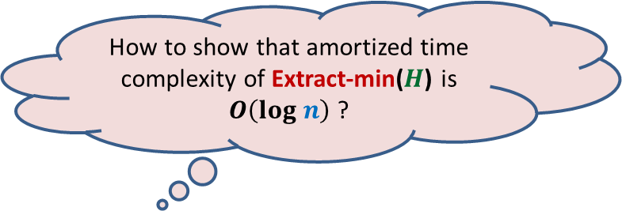
Insert($x,H$) on a Binomial Heap
Insert($4,H$)
$$0$$ | $$1$$ | $$2$$ | $$3$$ | $$4$$
Insert($19,H$)
Total computation done =
No. of trees in the root list of $H_{old}$
(say $t(H_{old})$)
+
No. of linking of trees carried out
Insert($2,H$)
Extract-min($H$)
Why ?
null
null
Head
O($t(H_{old}))$
5
$$4$$
$$19$$
7
15
9
6
8
19
23
67
11
How to show that amortized time complexity of Extract-min($H$) is $O\left(log n\right)$ ?
Because the Total no. of trees linked is bounded by ($t(H_{old})$
63
We need to carefully examine
$H_{old}$ and $H_{new}$
$$H$$

Slide 22

Insert($x,H$) on a Binomial Heap
Insert($4,H$)
Insert($19,H$)
Insert($2,H$)
Extract-min($H$)
Head
5
$$4$$
$$19$$
7
15
9
6
8
19
23
67
11
63
$$H_{new}$$

Slide 23

Insert($x,H$) on a Binomial Heap
Insert($4,H$)
Insert($19,H$)
Insert($2,H$)
Extract-min($H$)
Head
8
6
5
$$4$$
$$19$$
$$2$$
11
7
15
9
19
23
67
63
$$H_{old}$$

Slide 24




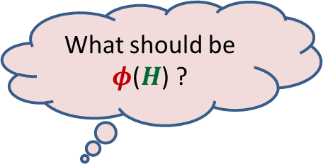

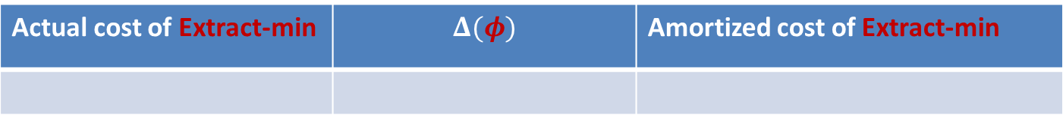

Insert($x,H$) on a Binomial Heap
Insert($4,H$)
Key point used in the analysis :
Max. degree of a tree in a Binomial Heap of size $n$= $log_{2} n$
Insert($19,H$)
Insert($2,H$)
Extract-min($H$)
What should be $φ$($H$) ?
Head
$φ$($H$): $c$ $t(H)$
5
$$4$$
$$19$$
7
15
9
6
8
19
23
67
11
63
Actual cost of Extract-min | $$Δ(φ)$$ | Amortized cost of Extract-min
$$H_{new}$$
$$c t(H_{old})$$
$$≤c( {t(H}_{new}) − t\left(H_{old}\right))$$
$$≤c(log n)$$
$$log n$$

Slide 25

Operations on a Heap
 | Binary heap
Binomial heap
Binomial heap
Fibonacci heap
Find-min($H$)
O($1$)
O($\log{n}$)
O($1$)
O($1$)
Insert($H$, $x$)
O($\log{n}$)
O($\log{n}$)
O($1$)
O($1$)
Extract-min($H$)
O($\log{n}$)
O($\log{n}$)
O($\log{n}$)
O($\log{n}$)
amortized
amortized
Decrease-key($H$,$x$,$y$)
O($\log{n}$)
O($\log{n}$)
O($\log{n}$)
O($1$)
amortized
Merge-heaps($H_{1}$,$H_{2}$)
O($n$)
O($\log{n}$)
O($1$)
O($1$)

Slide 26



Decrease-key on a Binomial Heap
Head
3
6
1
11
7
4
9
19
23
67
$$B_{0}$$
$$B_{1}$$
$$B_{3}$$
63
2

Slide 27
Decrease-key on a Binomial Heap
Head
3
6
1
11
7
4
9
2
23
67
$$B_{0}$$
$$B_{1}$$
$$B_{3}$$
19

Slide 28
Decrease-key on a Binomial Heap
O($\log{n}$) time
Head
3
6
1
11
2
4
9
7
23
67
$$B_{0}$$
$$B_{1}$$
$$B_{3}$$
19

Slide 29

Idea for O($1$) time for Decrease-key
Head
3
6
1
11
7
4
9
19
23
67
$$B_{0}$$
$$B_{1}$$
$$B_{3}$$
63

Slide 30



Idea for O($1$) time for Decrease-key
Head
3
6
1
11
2
4
9
19
23
67
$$B_{0}$$
$$B_{1}$$
$$B_{3}$$
63

Slide 31

Fibonacci heap of size $n$
Head

Slide 32

Fibonacci heap of size $n$
Maximum degree of a tree in a Heap of size $n$=O($log_{2} n$)
Head

Slide 33
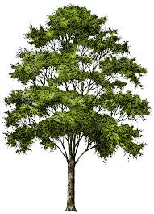

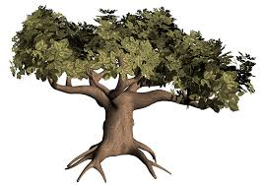
Inspiration from a gardener
Prune the tree to restore the shape of the tree
Binomial Tree☺
A bushy tree ☹

Slide 34

Decrease-key($H$,$x$,$Δ$) in Fibonacci heap
Mark a node as soon as it loses its first child
Head

Slide 35

Decrease-key($H$,$x$,$Δ$) in Fibonacci heap
Mark a node as soon as it loses its first child
Move the subtree rooted at a marked node to root list as soon as it loses second child.
Unmark the marked node when it is added to root-list.
Head
Many subtrees may have to be added to the root list.
Can you see how ?
The following slide presents a generic description of Decrease-key($H$,$x$,$Δ$) involving cascaded-cuts

Slide 36
Decrease-key($H$,$x$,$Δ$) in Fibonacci heap
Head

Slide 37

Decrease-key($H$,$x$,$Δ$) in Fibonacci heap (using Cascaded-cuts)

Slide 38
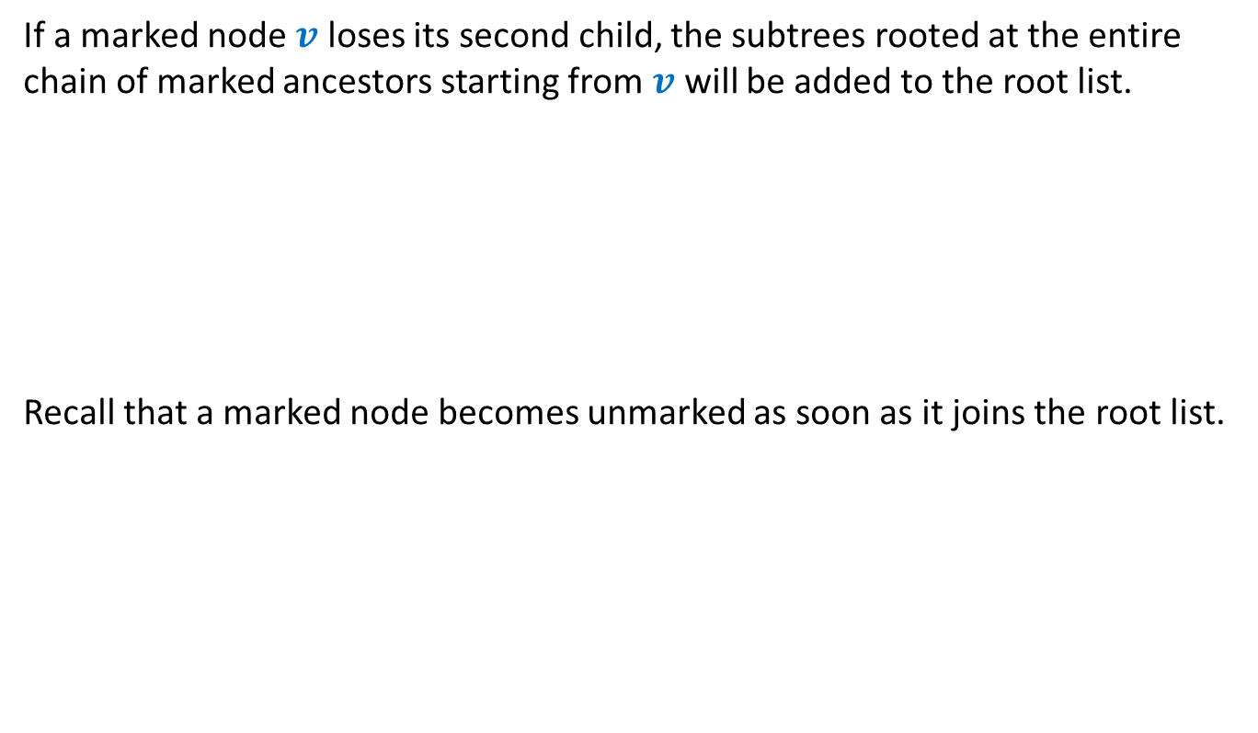
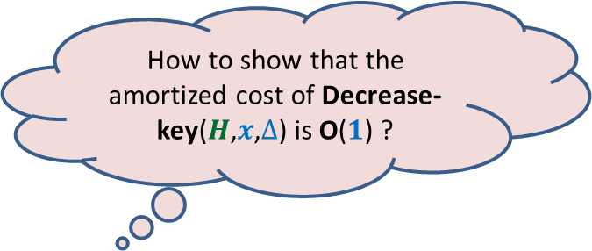
Decrease-key($H$,$x$,$Δ$) in Fibonacci heap (using Cascaded-cuts)
If a marked node $v$ loses its second child, the subtrees rooted at the entire chain of marked ancestors starting from $v$ will be added to the root list.
Recall that a marked node becomes unmarked as soon as it joins the root list.
How to show that the amortized cost of Decrease-key($H$,$x$,$Δ$) is O($1$) ?

Slide 39


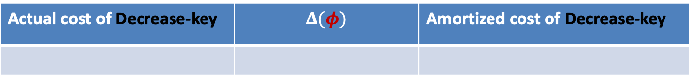


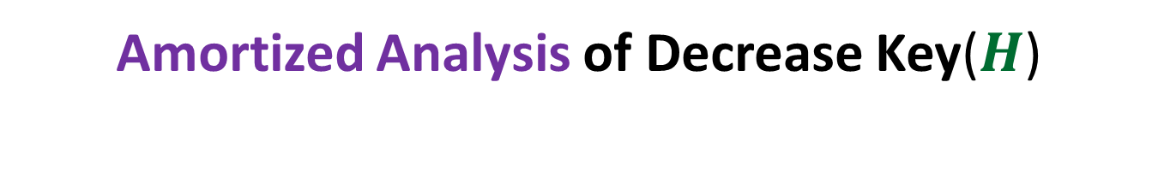




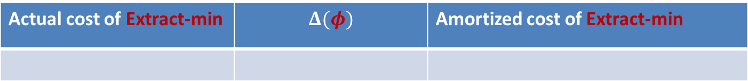



Amortized Analysis of Decrease Key($H$)
Convince yourself that the revised potential function works for Extract-min as well.
The existing Potential function
Are we done ?
$$+ c m(H)$$
$φ$($H$): $c$ $t(H)$
$$+ 2c m(H)$$
$m(H)$: the number of marked nodes
No
Actual cost of Decrease-key | $$Δ(φ)$$ | Amortized cost of Decrease-key
$c \left(m\left(H_{old}\right)−m\left(H_{new}\right)\right)$+ $c$
$c m\left(H_{new}−H_{old}\right)+$ $c$
$$2c$$
Actual cost of Extract-min | $$Δ(φ)$$ | Amortized cost of Extract-min
$$c t(H_{old})$$
$$≤c(log n − t\left(H_{old}\right))$$
$$c(log n)$$
We need to show that the maximum degree of a tree in a Heap of size $n$= O($log n$)
Homework: Attempt this problem. We shall discuss it in the next class.

